Slide 1
REN302: AUTOMATION CONTROL SYSTEM
Lecture 3
PROGRAMMABLE LOGICAL CONTROLLER SYSTEMS
Eng. NIYITEGEKA Janvier
RP/IPRC TUMBA/ RE DEPARTMENT

Slide 2
Sequence and Logic Control
The control systems operate by turning on and off switches, motors, valves, and other devices.
For example in the control of a reciprocating conveyor system, analog motor control is not applied. Simple on-off control is adequate. Therefore for this application, the motor-starter actuation system may be considered as discrete.

Slide 3
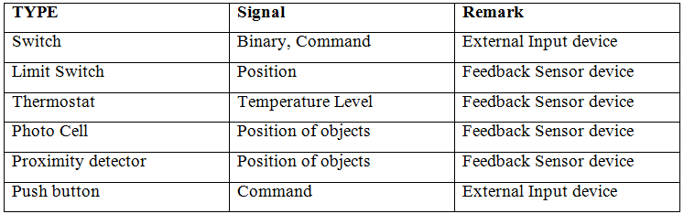
Discrete Sensors

Slide 4
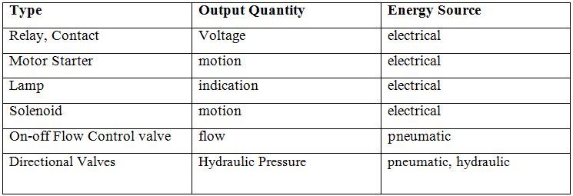
Discrete Output Actuation Devices

Slide 5
Programmable Logic Controllers (PLC)
A PLC is a special purpose industrial microprocessor based real-time computing system.
PLC stands for “Programmable Logic Controller”.
A PLC is a computer specially designed to operate reliably under harsh industrial environments – such as extreme temperatures, wet, dry, and/or dusty conditions.
It is used to automate industrial processes such as a manufacturing plant’s assembly line, an ore processing plant, or a wastewater treatment plant.

Slide 6
PLCs share many features of the personal computer you have at home.
They both have a power supply, a CPU (Central Processing Unit), inputs and outputs (I/O), memory, and operating software (although it’s a different operating software).
The biggest differences are that a PLC can perform discrete and continuous functions which a PC cannot do.
PLCs plays a crucial role in the field of automation, using forming part of a larger SCADA system.

Slide 7
SCADA Control System
SCADA stands for “Supervisory Control and Data Acquisition”.
SCADA systems gather pieces of information and data from a process.
It records the data, as well as representing the collected data on various HMIs.
This enables process control operators to supervise what is going on in the field, even from a distant location.
It also enables operators to control these processes by interacting with the HMI.

Slide 8
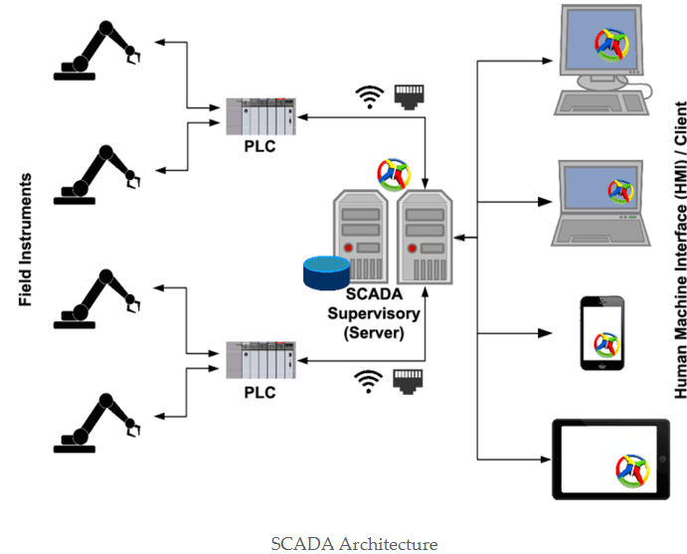
SCADA Architecture

Slide 9
SCADA systems allows the operator to keep a track of the entire process from his place or control room.
One such excellent example is, SCADA systems are used extensively in the Oil and Gas sector.
Large pipelines will be used to transfer oil and chemicals inside the manufacturing unit.
In case, if some leakage occurs, a SCADA system is used to identify the leakage and transmits it to the system, displays the information on the computer screen and also gives an alert to the operator.

Slide 10
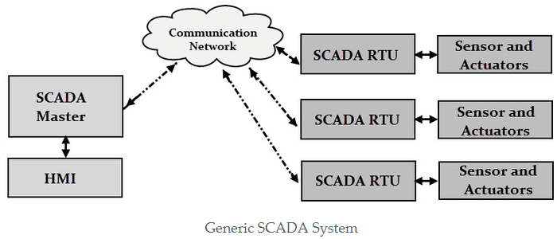

Slide 11
EVOLUTION OF PLC
Before the advent of microprocessors, industrial processes were performed using elaborated control panels containing electromechanical or relays, contactors and switches, indicator, lamps, mechanical or electronic timers and counters etc.
the development of microprocessors in the early 1970’s quickly led to the development of the PLCs.

Slide 12
Advantages of PLC over control panels.
Programming the PLC is easier than wiring physical components;
The PLC can be reprogrammed using user-friendly programming devices. Controls must be physically rewired.
PLCs take up much less space.
Installation and maintenance of PLCs is easier, and with present day solid-state technology, reliability is greater.
The PLC can be connected to a plant automation system, supervised and monitored.

Slide 13
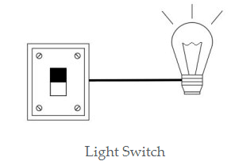
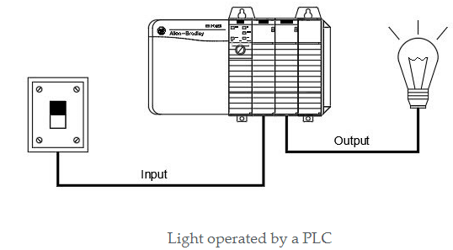
Cont’d

Slide 14
Application Areas
Logic/Sequence control
PID control and computing
Operator control and monitoring
Plant start-up, shut-down
Cement Manufacturing
In boilers – Thermal Power Plant

Slide 15
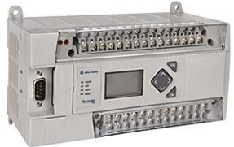
TYPES OF PLCs
1. Compact PLC
The compact PLC don’t have the capability to expand the modules as it has fixed number of I/O module and external I/O card.

Slide 16
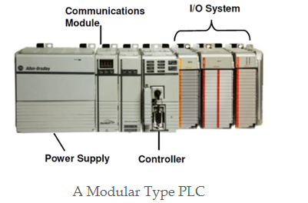
2. Modular PLC
This type of PLC permits multiple expansion through “modules”.
I/O components can be increased.
It is easier to use because each component is independent of each other

Slide 17
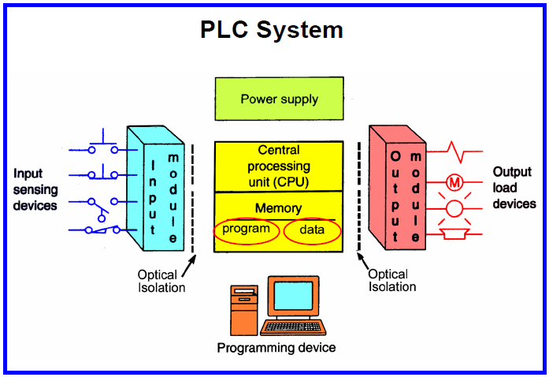
PLC Hardware

Slide 18
CPU and Memory module
This is the main computing module where ladder logic and other application programs are stored and processed.

Slide 19
Power supply:
The power supply given to a particular PLC depends upon the Manufacturers specifications.
A power supply may be inbuilt processor module or a separate module.
Common voltage levels required by the PLC are 24Vdc, 120Vac, 220Vac.

Slide 20
Input and output modules:
Input and output modules are specified according to the requirements of a particular application.
I/O can be either discrete or analog .
Discrete I/O modules are capable of handling ON-OFF type inputs or outputs.
Analog I/O modules are specified according to desired resolution and voltage or current range.

Slide 21
Programming Unit:
Programming Unit allows the engineer to enter and edit the program to be executed.
More advanced systems employ a personal computer which enables the programmer to write, view and edit the program and download it to the PLC.

Slide 22
Indicator lights
These indicate the status of the PLC including power on, program running, and a fault.
These are essential when diagnosing problems.

Slide 23
Analog input modules
Analog input modules convert analog process level signals to digital values, which are then processed by the digital electronic hardware of the programmable controller.
The analog modules sense analog signals in the range ± 5 V, ± 10 V or 0 to 10 V.

Slide 24
Output Modules
Outputs to actuators allow a PLC to cause something to happen in a process.
The outputs from these modules may be used to drive actuators.
Consequently, they include circuitry for current / power drive using solid-state electronics such as transistors for DC outputs or triacs for AC outputs.

Slide 25
Analog Output Module
Analog output modules convert digital values from the PLC processor module into an analog signal required by the process.
These modules therefore require a D/A converter for providing analog outputs.

Slide 26
Digital Output Module
Digital output modules convert internal signal levels of the programmable controllers into the binary signal levels required externally by the process.

Slide 27
Operation of PLC:
The PLC performs mainly two functions while executing the program
Update the input/outputs:
Solve the Ladder logic:

Slide 28
Update the input/outputs:
In simple words we can say that the information in Input and Output image registers of the processor is updated.
Image registers help in storing the information in memory.
As inputs are received in real time by the PLC, I/P image register stores the received information in the memory and also transfer the executed information to the O/P image register.
The O/P image register then sends the O/P data to the O/P unit. This process is also called as scanning.

Slide 29
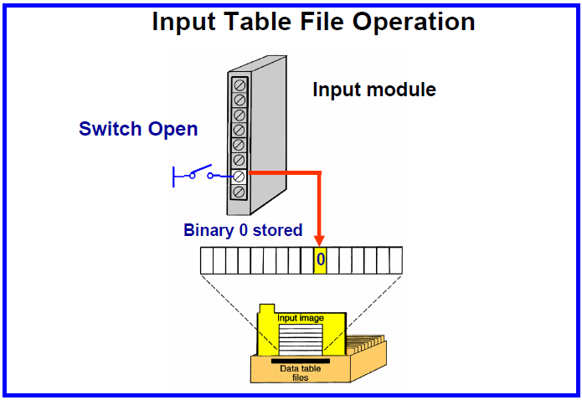
Update the input

Slide 30
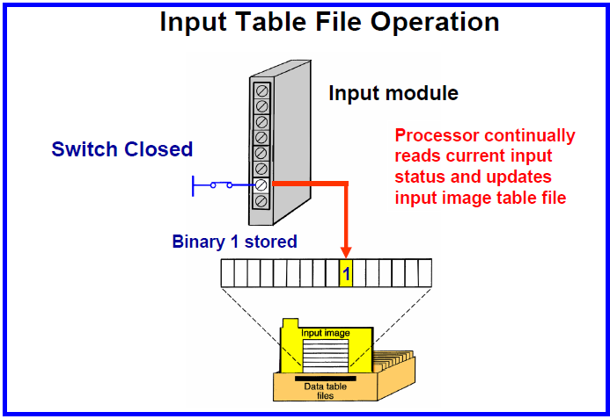

Slide 31
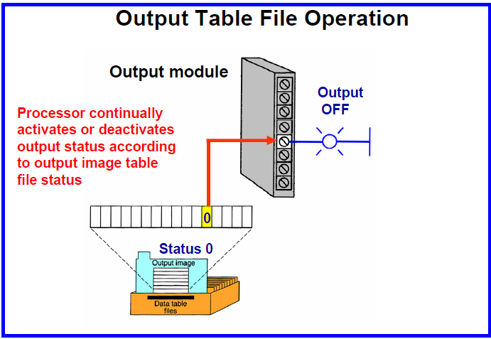
Output image register

Slide 32
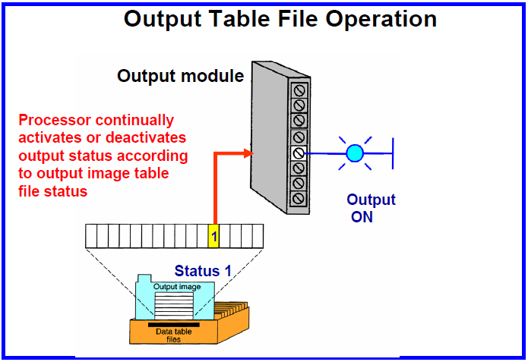

Slide 33
Solve the Ladder logic:
After the I/O update, PLC begins executing the commands in the user program (Ladder diagram) In other words, the ladder logic is executed.
The PLC executes the ladder left to right and top to bottom.
Usually the contact configuration on the left side of each rung can be visualized as switches and contacts while the coils on the right as O/P lamps.

Slide 34
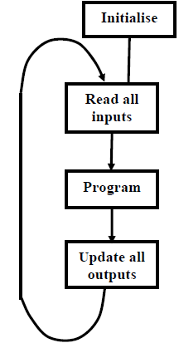
Program Execution

Slide 35
Cont’d
After the PLC is initialized, the processor reads the individual inputs. This status of the input is stored in the process- image input table (PII).
This processor processes the program stored in the program memory and the results are written into a process-image output table (PIQ).
The status from the PIQ will be transferred to the outputs and then be switched on and/or off. Afterwards it begins the execution of the next cycle from step 1.

Slide 36
PLC Programming Languages
Textual Language
Instruction list
Structured text
Graphical Form
Ladder Diagrams (LD) (i.e. Ladder Logic)
Function Block Diagram (FBD)
Sequential Function Chart (SFC)

Slide 37
PLC LADDER PROGRAMMING
A very commonly used method of programming PLCs is based on the use of ladder diagrams.
Writing a program is then equivalent to drawing a switching circuit.
The ladder diagram consists of two vertical lines representing the power rails.
Circuits are connected as horizontal lines, i.e., the rungs of the ladder, between these two verticals.
Each rung consist of a set of inputs on the left end of the rung and a single output at the right end of each rung.

Slide 38
Drawing a ladder diagram conventions
The vertical lines of the diagram represent the power rails between which circuits are connected.
Each rung on the ladder defines one operation in the control process.
A ladder diagram is read from left to right and from top to bottom.
Each rung must start with an input or inputs and must end with at least one output.
When the PLC is in its run mode, it goes through the entire ladder program to the end, the end rung of the program being clearly denoted, and then promptly resumes at the start.
The inputs and outputs are all identified by their addresses, the notation used depending on the PLC manufacturer.
The action of the input is equivalent to opening or closing a switch.

Slide 39
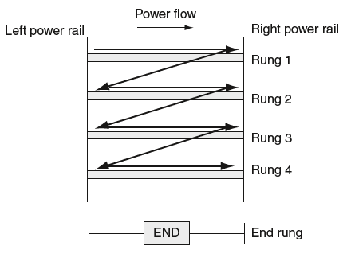
Scanning the ladder program

Slide 40
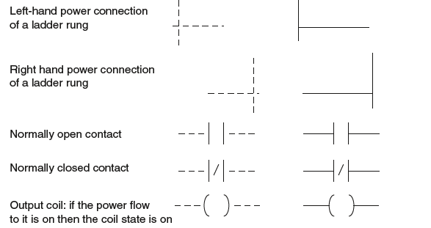
Basic symbols

Slide 41
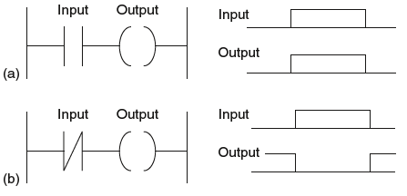
Ladder program examples

Slide 42
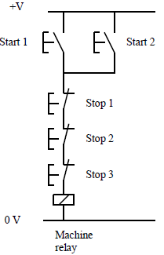
Conditional Logic
A simple example of conditional logic could be stated as follows:
“A machine switches on if either of two start switches are closed and all of three stop switches are closed.”

Slide 43
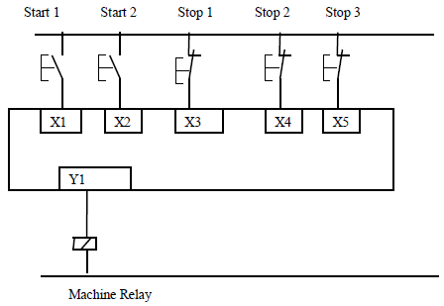
PLC wiring

Slide 44
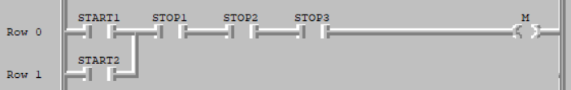
PLC ladder program

Slide 45
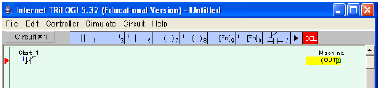
Normally closed contacts

Slide 46
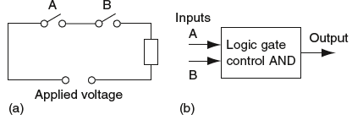
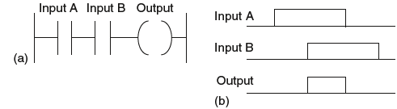
AND FUNCTION
This indicates a situation where an output is not energized unless two, normally open, switches are both closed.
Switch A and switch B have both to be closed, which thus gives an AND logic situation.

Slide 47
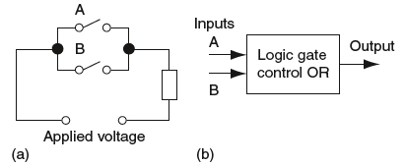
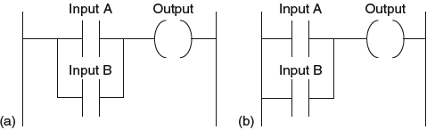
OR Function
This indicates an electrical circuit where an output is energized when switch A or B, both normally open, are closed.

Slide 48
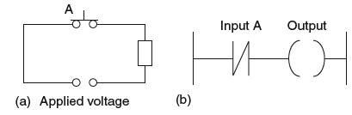
NOT FUNCTION
When there is an input to the switch, it opens and there is then no current in the circuit.

Slide 49
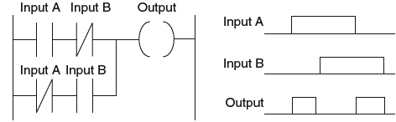
Exclusive OR (XOR)
It gives an output when either of the inputs is 1 but not when both are 1.

Slide 50
Latching
We use latching in situations where it is necessary to hold an output energized, even when the input ceases.
A simple example of such a situation is a motor, which is started by pressing a push button switch.
Though the switch contacts do not remain closed, the motor is required to continue running until a stop push button switch is pressed.

Slide 51
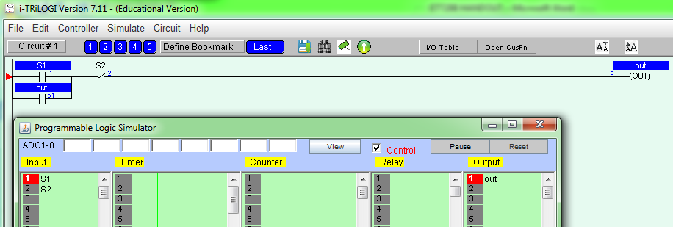
Example of Latching program

Slide 52
Exercise1
Write a PLC program to implement the conditional logic statements (a), (b) and (c) below.
a) A PLC output is to switch on if any of three inputs is switched on.
b) A PLC output is to switch on if any one of three inputs is switched on but not two or more.
c) A PLC output is to switch on if any two inputs are switched on, but not the third.

Slide 53
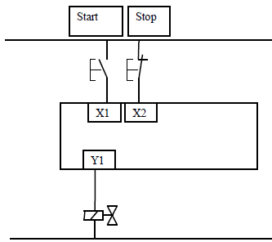
Exercise2
The following figure shows a plc wiring diagram with two push button and one output as motor. Develop a ladder logic program for motor control using start and stop push button

Slide 54
Exercise3
Write a ladder diagram to switch on the machine by using either start1 or start2 push buttons and stop it using either stop1or stop2 or stop3 switches.

Slide 55
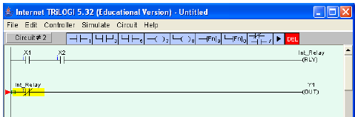
Internal relays
These have the same properties as outputs but they only exist in software.

Slide 56
Timers
The delay-on timer introduces a delay between the start of one event and the start of another.
For example, when a start push button is pressed, the pneumatic cylinder extends, remains extended for 5 seconds and then returns

Slide 57
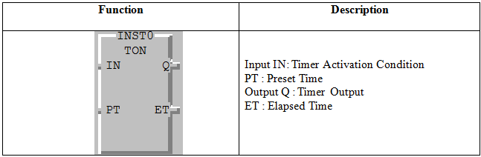
Function Block of ON Delay Timer (TON)

Slide 58
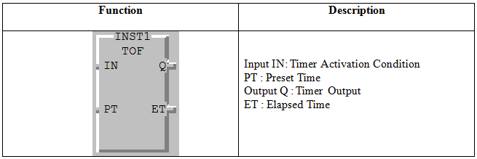
Function Block of OF Delay Timer (TOFF)

Slide 59
Exercise1
By using a pneumatic cylinder as output and a limit switch as input develop a ladder diagram to extend the rod of the cylinder once the start push button is pressed. When the cylinder rod closes to limit switch, the system should wait during of 5 seconds and then after the rod returns back.

Slide 60
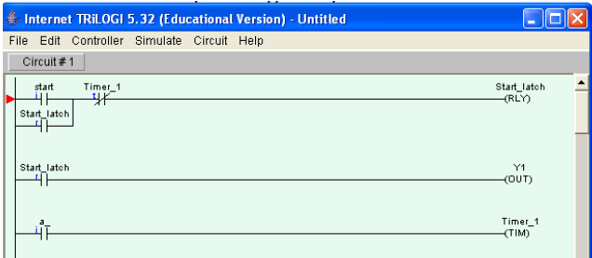
Solution

Slide 61
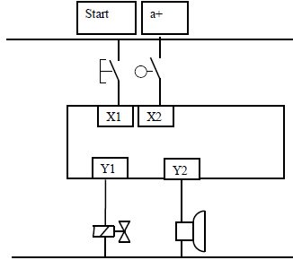
Exercise2
Using the same hardware with the addition of an alarm as a second output develop a ladder diagram to set alarm on during of 10seconds once the rod is closed to the limit switch and then after cylinder returns back:

Slide 62
COUNTERS
A counter allows a number of occurrences of input signals to be counted. The counter is set to a preset number value and when this value of input pulses has been received, it will operate its contacts. A second input or software coil is provided to reset the current value of the counter to zero.

Slide 63
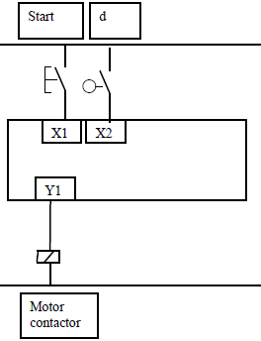
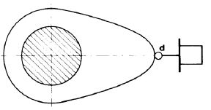
Exercise
Considering the following shaft, When a start button has been pressed the shaft is to make 10 revolutions and then stop. Pressing the start button also resets the counter

Slide 64

Questions and Discussions
Thank you

